Slide 1
usegalaxy.no tools and workflows
Erik Hjerde
ELIXIR Norway, Norwegian e-infrastructure for Life Sciences and usegalaxy.no

Slide 2
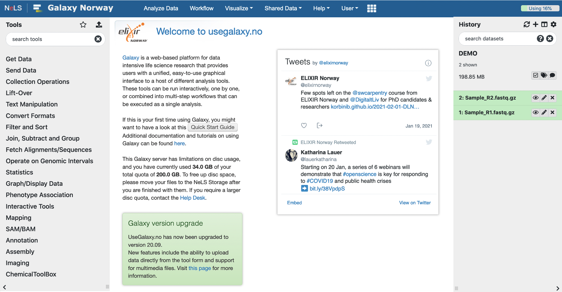
Galaxy tools
Tools are available from the Tool menu
Organised under sub-menus
Possible to browse and search by name
You can make your own list of favourite tools

Slide 3
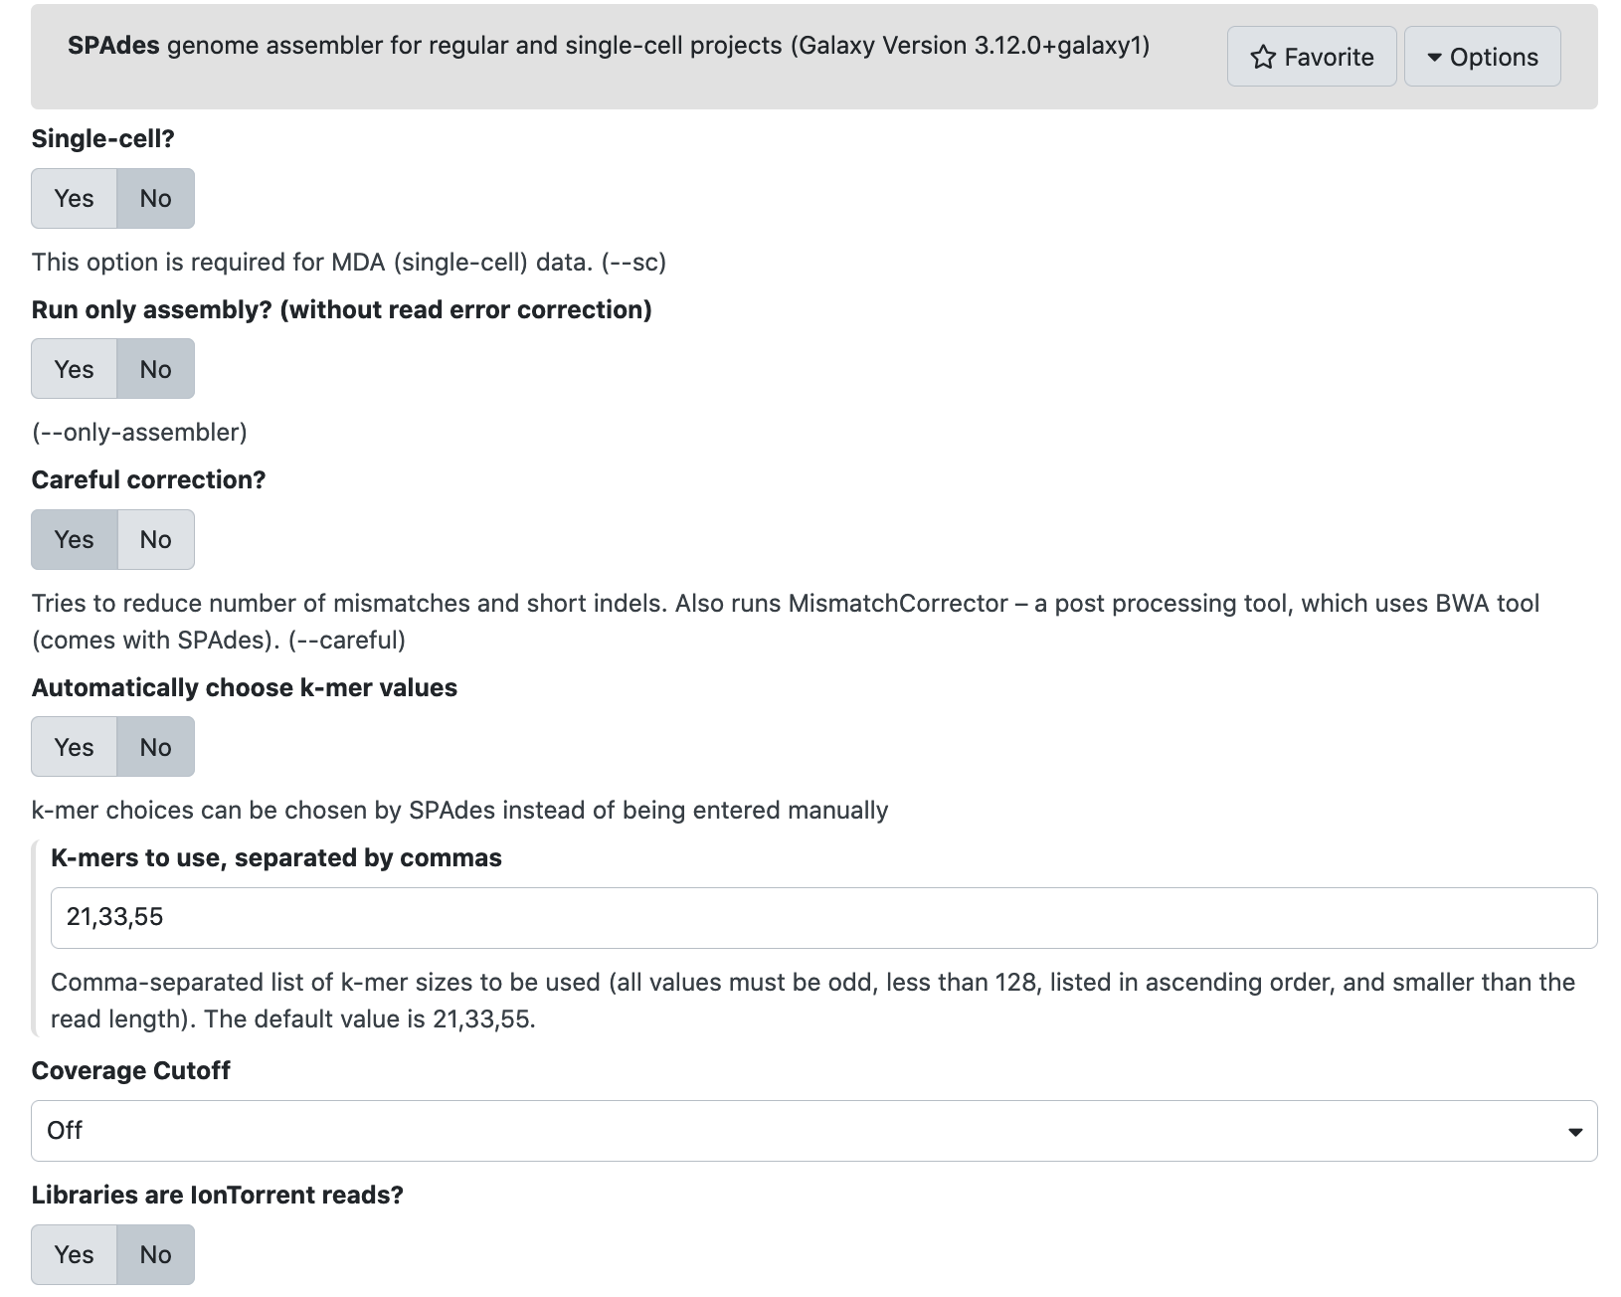
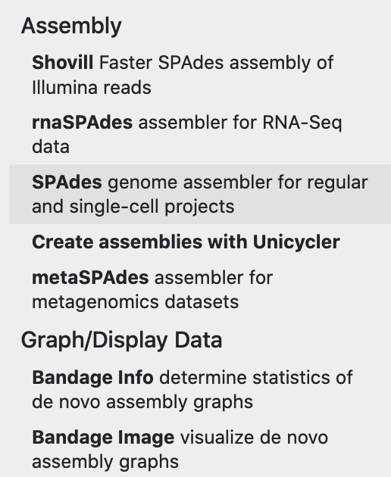
Galaxy tools = command line tools
Command line tools are wrapped into Galaxy so they become accessible with a GUI
Some Galaxy tools may have reduced the number of optional parameter settings for the tool
Example here is the assembly tool called SPAdes

Slide 4
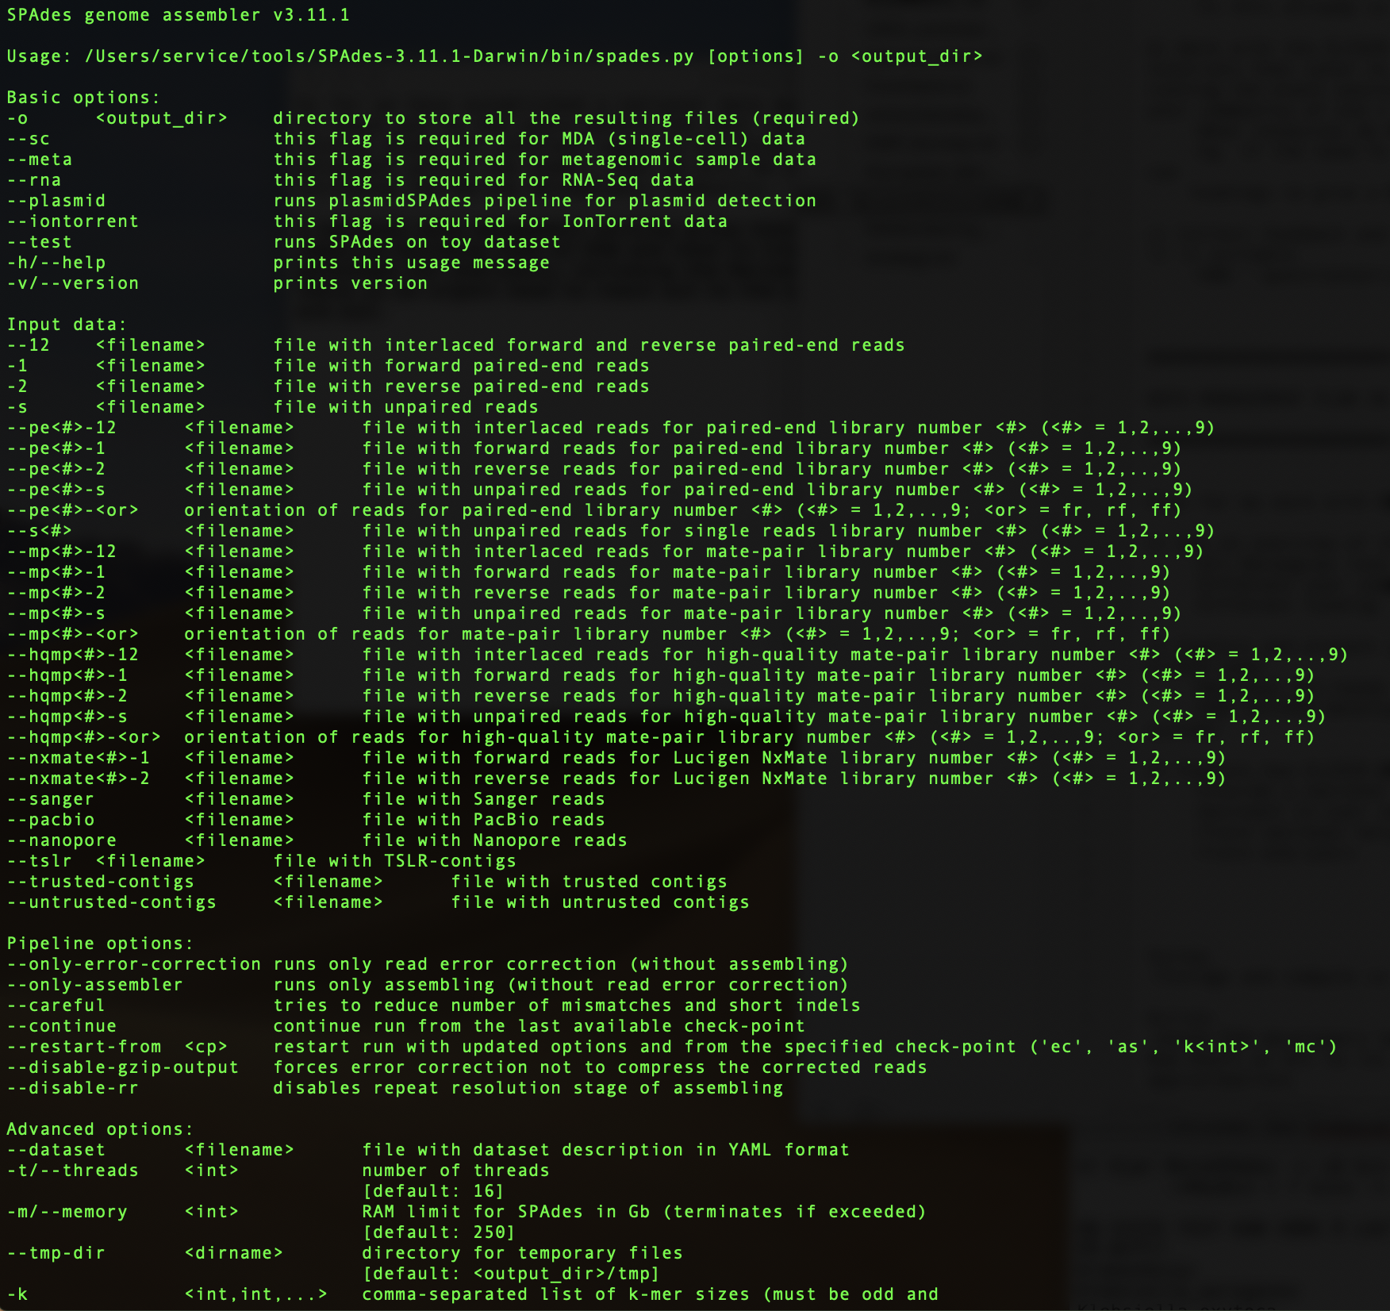
Command line vs Galaxy

Slide 5
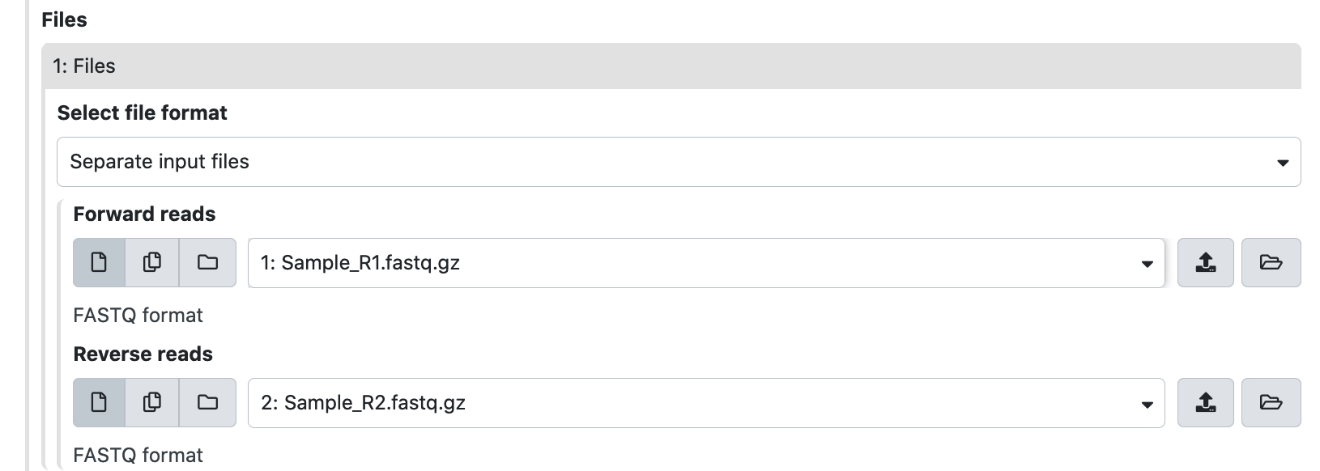
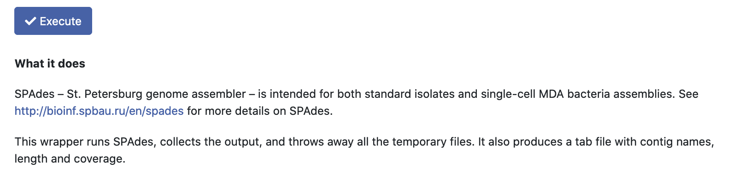
Running tools in Galaxy
Example running the tool SPAdes
Choose parameter settings
Select input files
Most tools comes with a detailed description of usage
…..
…..
…..

Slide 6
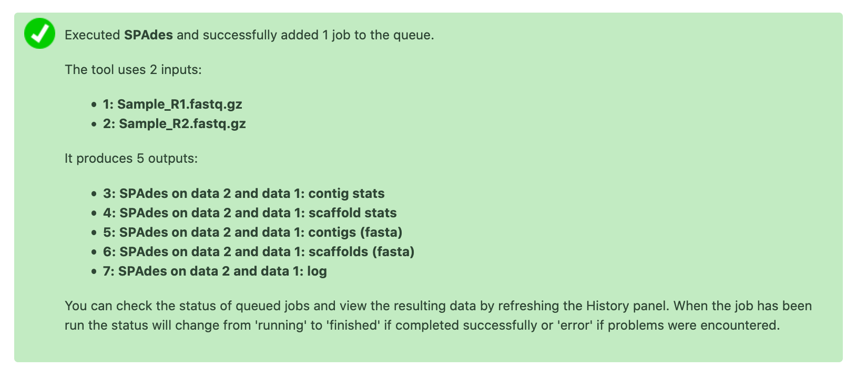
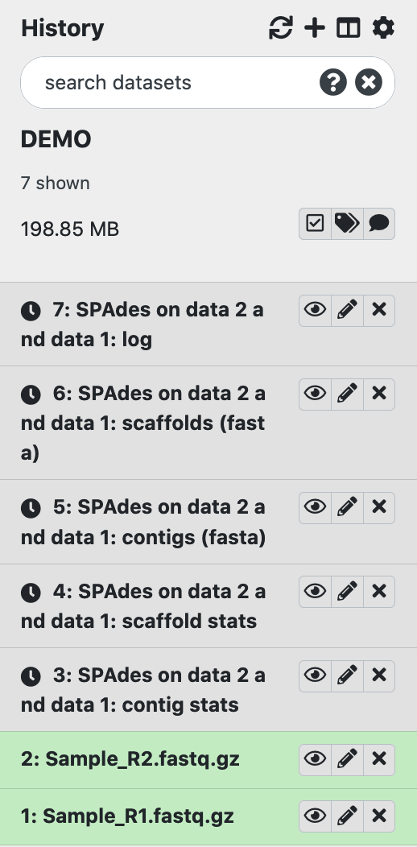
Running tools in Galaxy
The result files are first displayed in grey boxes. This means the job is pending.

Slide 7
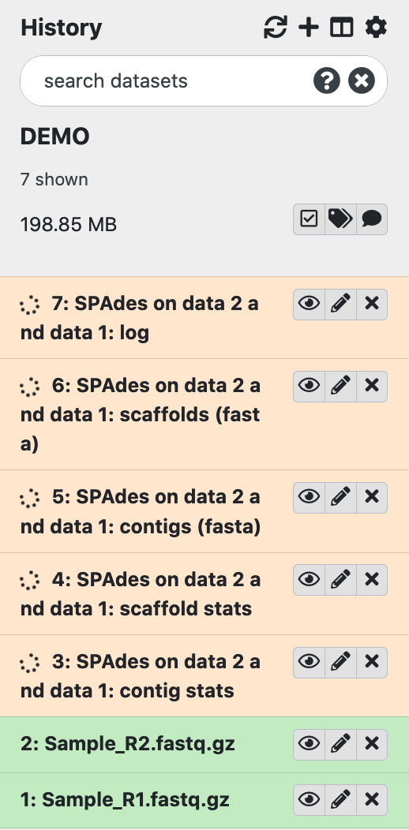
Running tools in Galaxy
When the job is running, the files turns yellow

Slide 8
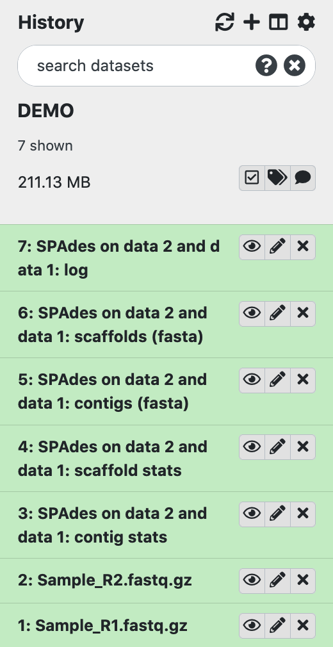
Running tools in Galaxy
When the job finish successfully, the files turn green

Slide 9
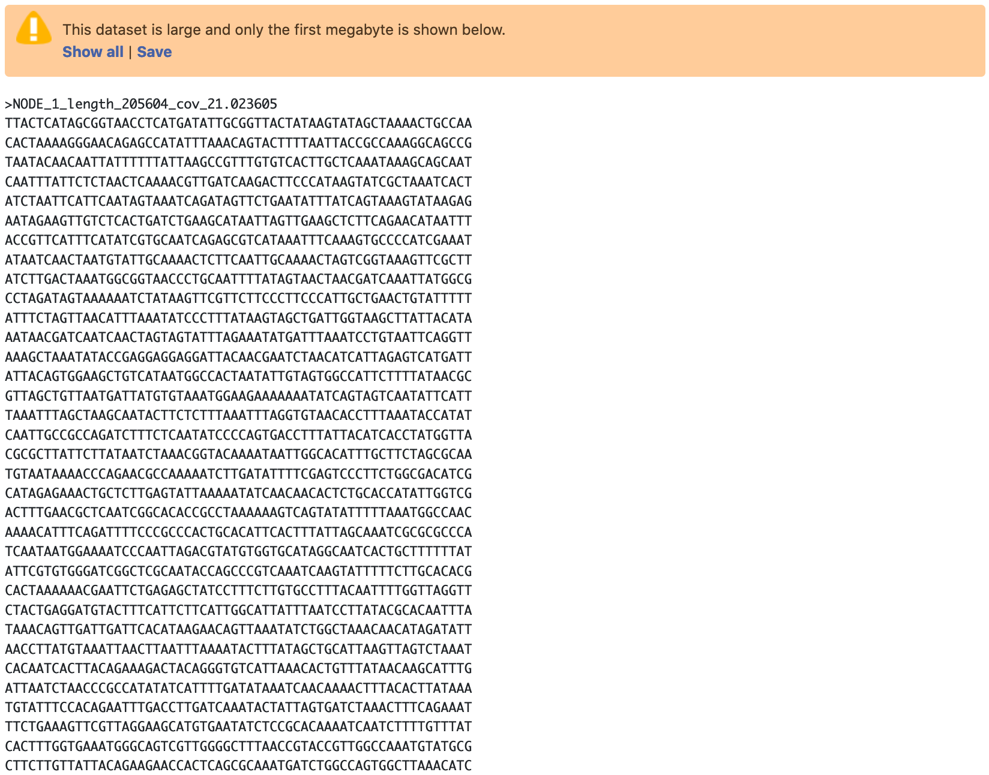
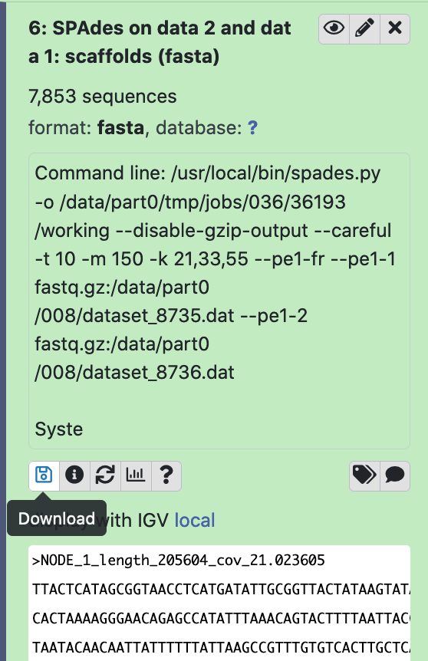
Tool output
It is possible to preview the output (result), view it in the main window or download the dataset
You can also copy the dataset over to another history

Slide 10
Galaxy workflows
A workflow in Galaxy is basically a string of tools, where the output from one tool becomes the input for the next
Tool 1
Tool 2
Tool 3
Output
Output
Output

Slide 11
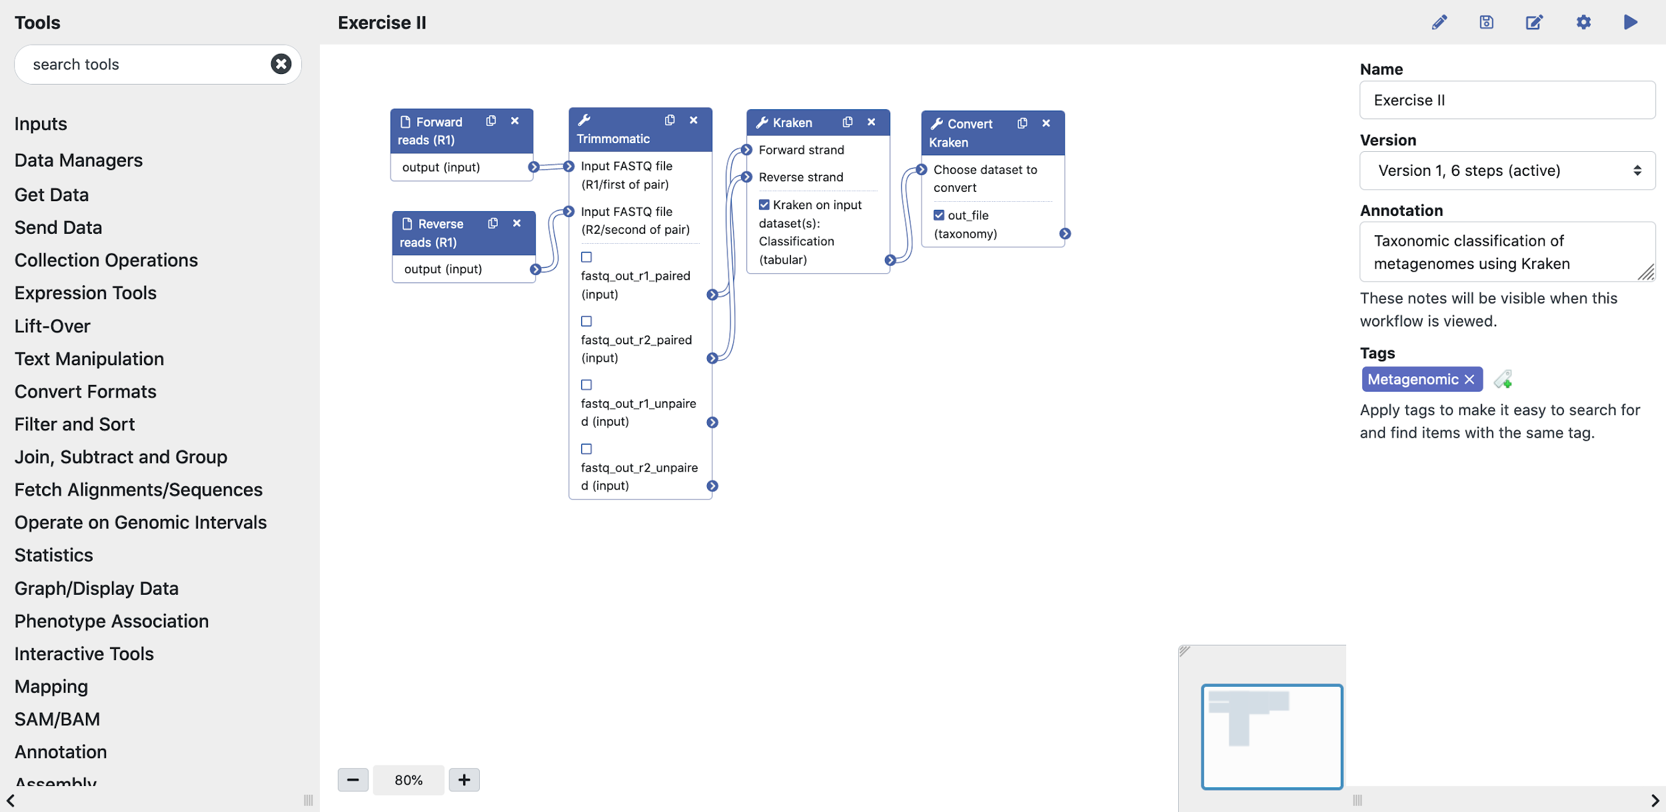
Galaxy workflows
The “nodules” indicate which output file from one acts as input for the next tool
Each workflow has a name and version
Additional text that describe the workflow and tags can be added

Slide 12
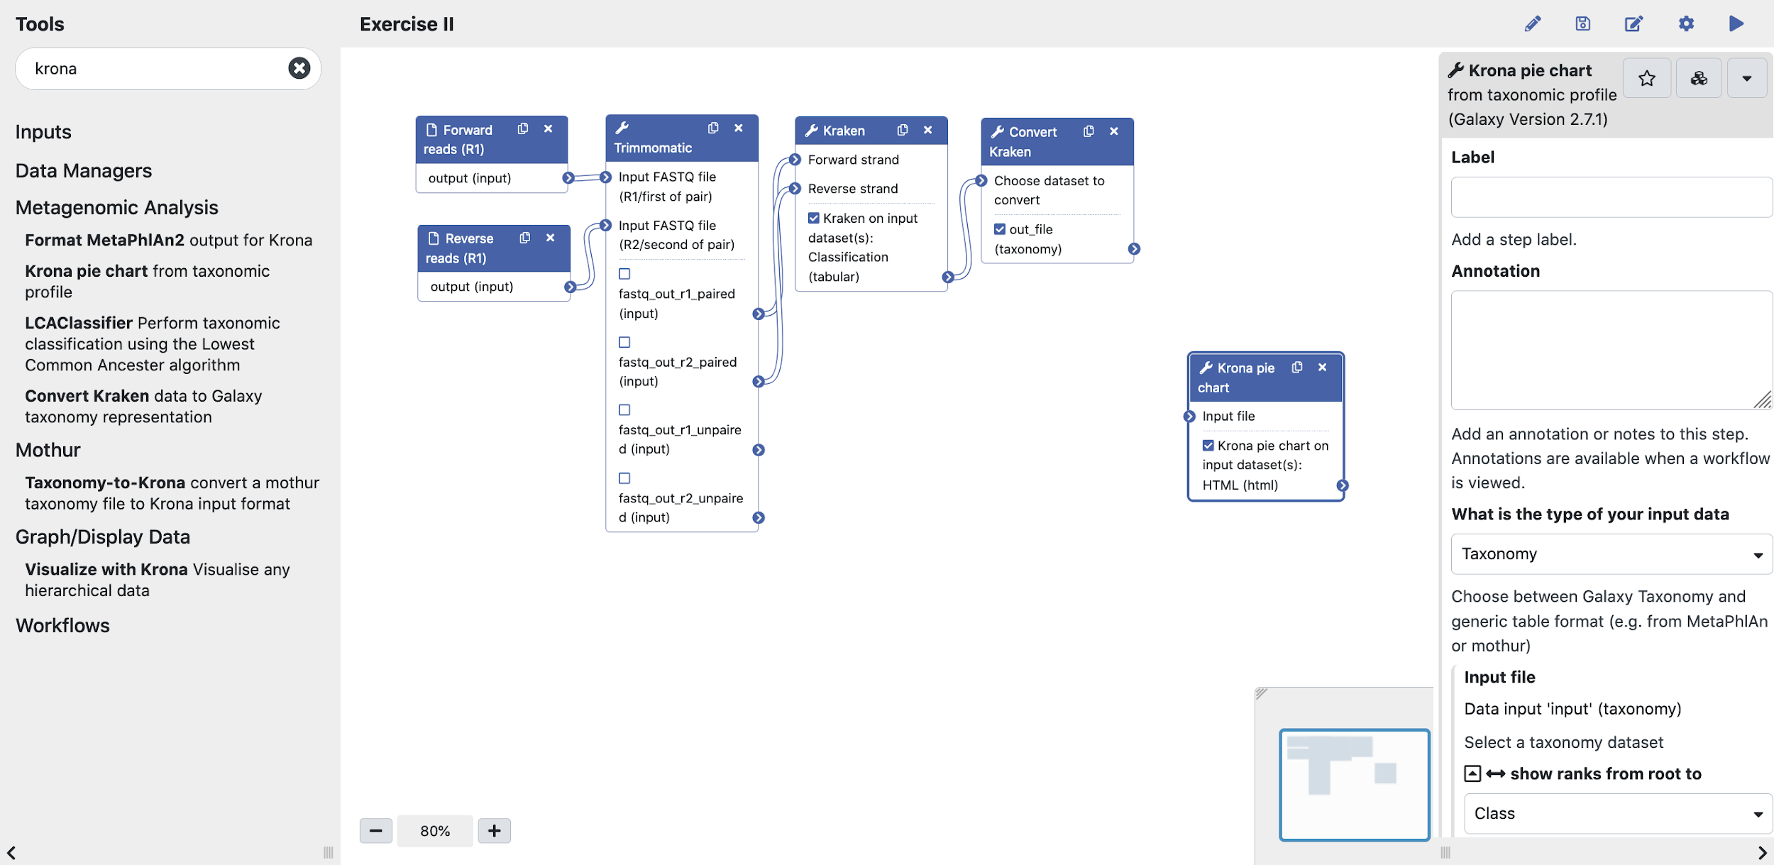
Galaxy workflows
New tools can be added by clicking on the tool in the Tool menu
The tool will appear in the workflow editor
Tool parameter settings can be pre-set or made up to the user to set when running the workflow

Slide 13

Galaxy workflows
The output from another tools can be connected as an input for the new tool
Remember to save the modified workflow

Slide 14
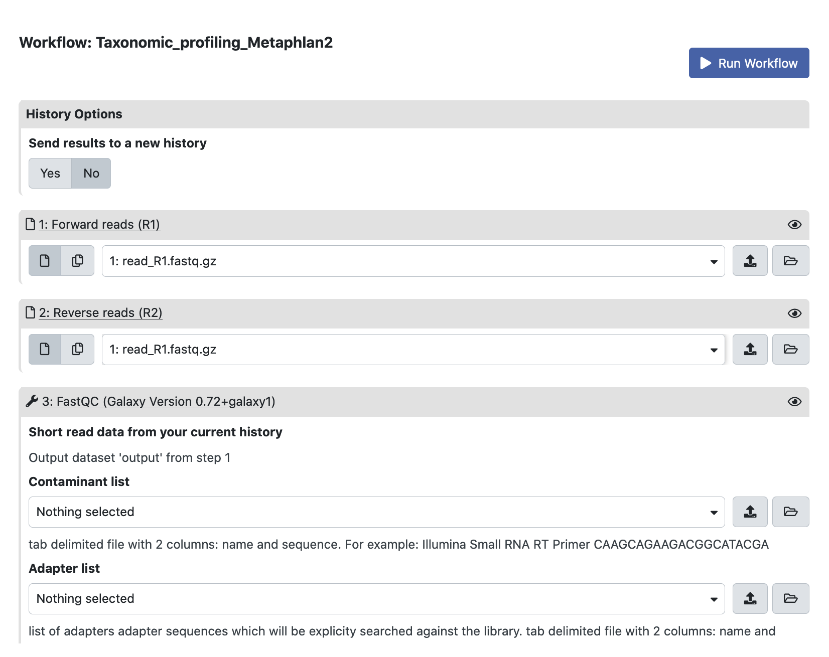
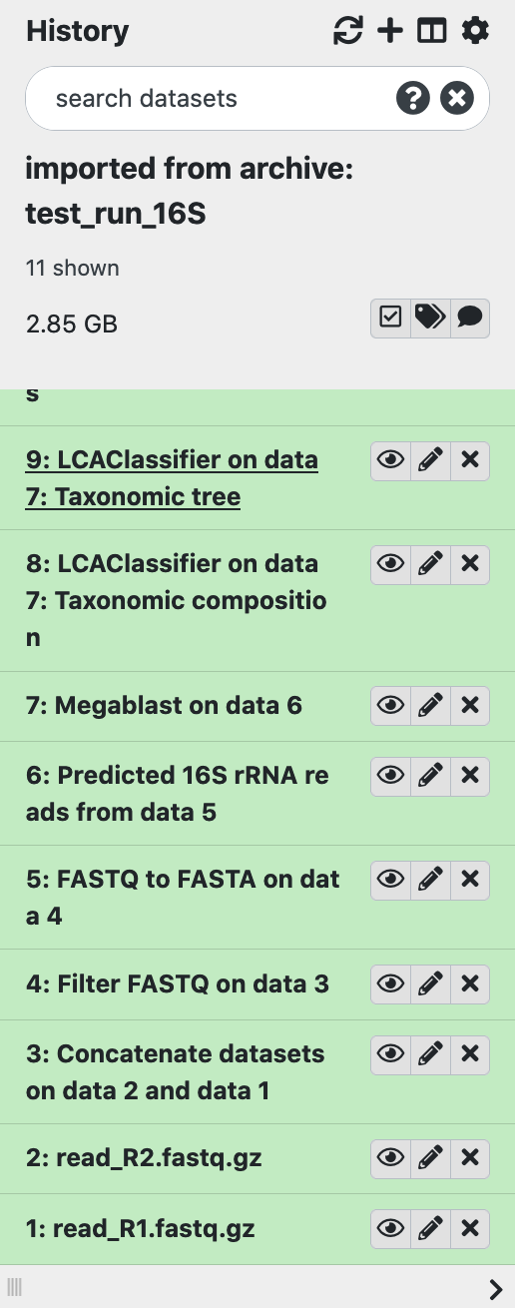
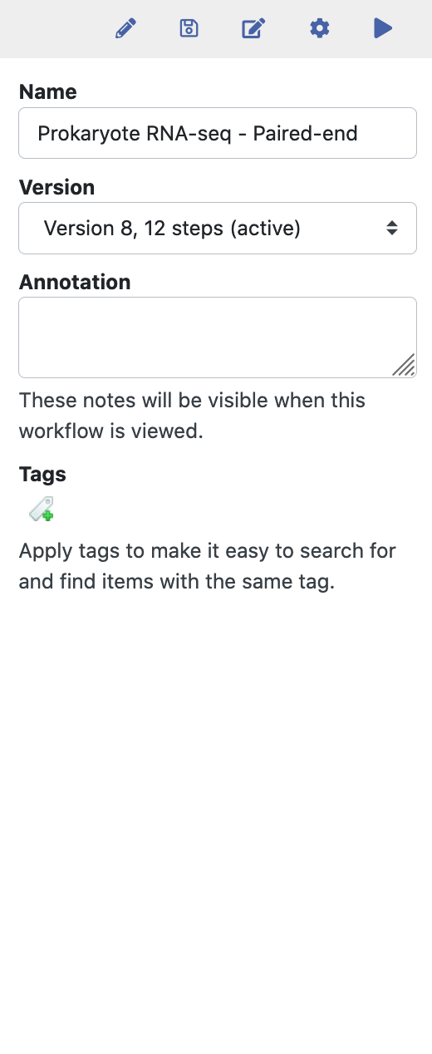
Galaxy – Running workflows
Select input files
Tools in the workflow will run successively
You can view and download the result files

Slide 15
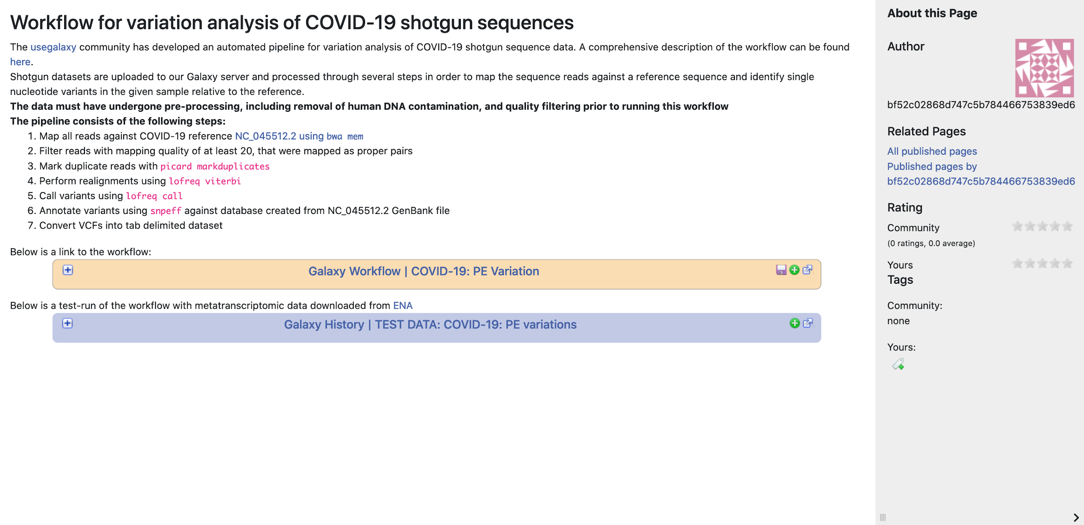
Workflow documentation in Usegalaxy.no
Each NeLS supported workflow is documented with instructions how to use it
Also test data sets available for each workflow

Slide 16
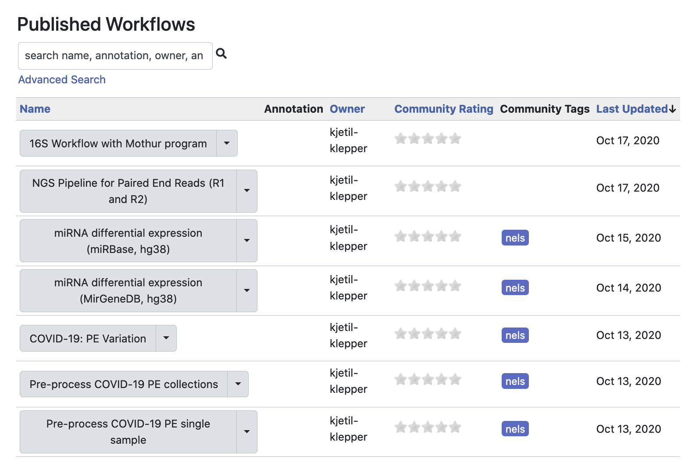
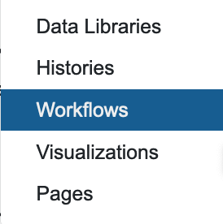
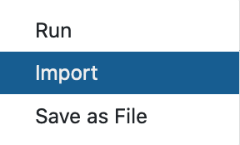
Shared workflows in usegalaxy.no
List of all workflows that are shared with all usegalaxy.no users
You can import shared data to you user
By selecting any workflow you can run data analysis, import into your user or save it on another computer

Slide 17
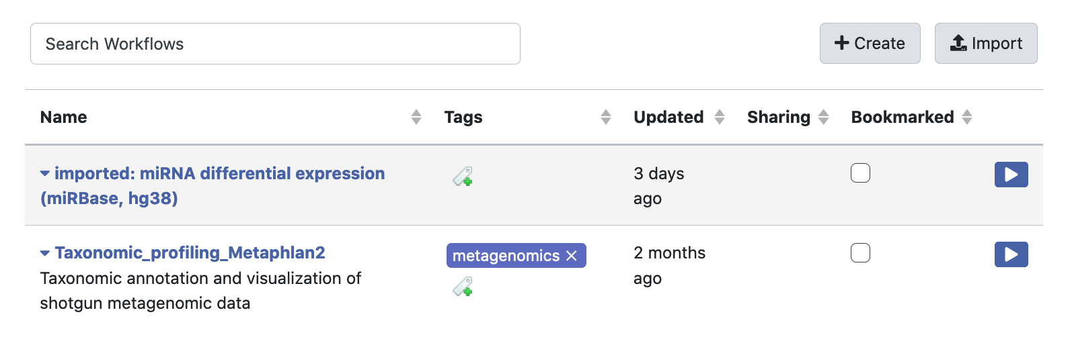
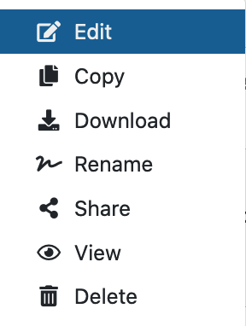
Your imported and self made workflows
You can also create new workflows here
For beginners a good tip is to import an existing workflow, and modify it to meet your needs. The workflow will only be changed in your version

Slide 18
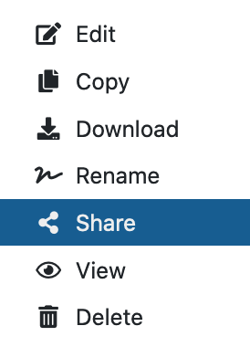
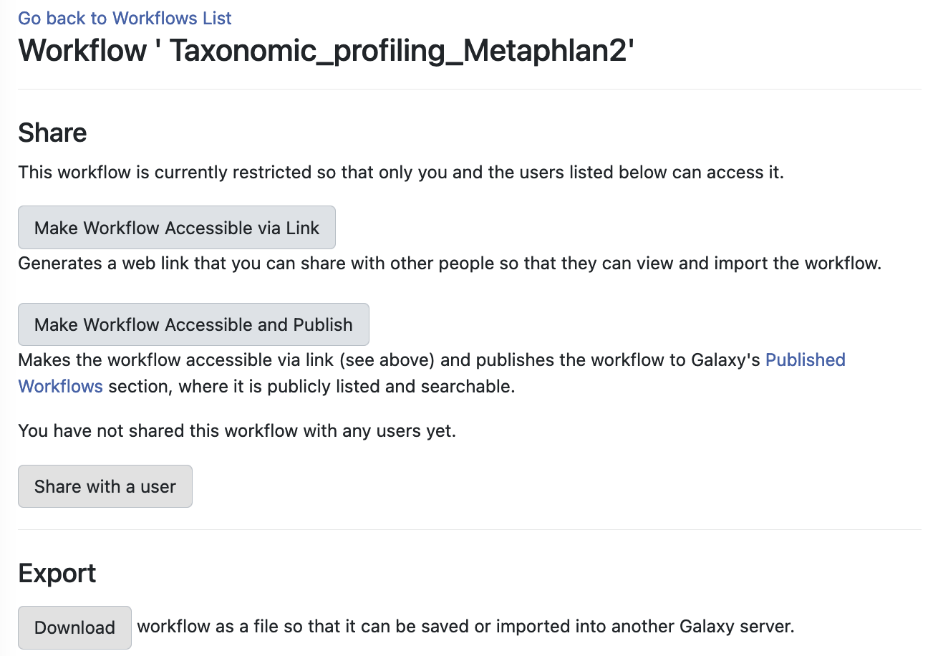
Sharing your workflows in usegalaxy.no
Self made or modified workflows can be shared with other usegalaxy.no users or made accessible via a link
You can also download a workflow and import it in another Galaxy

